Slide 1
Chapter 10
Responsive Web Design
with FlexGrid

Slide 2
Objectives
Applied
Design responsive web page layouts with CSS Grid Layout.
Knowledge
Explain the benefits and usage of CSS Grid Layout.
Define these terms as they apply to Grid Layout: grid, grid track, grid line, grid cell, grid area, and grid item.
Explain how to define named template areas.

Slide 3
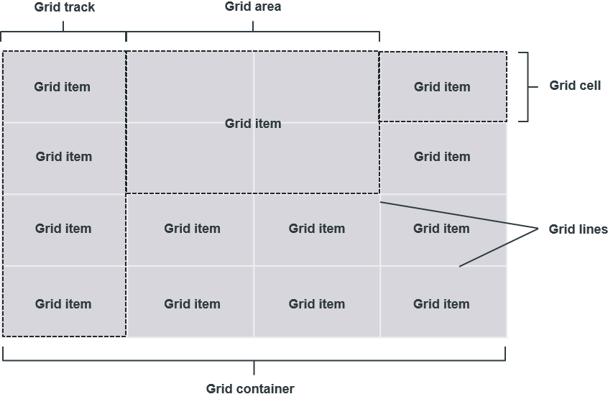
The components of a grid layout

Slide 4
The HTML and CSS for a 2 row by 3 column grid
The HTML
<main>
<div>Div 1</div> <div>Div 2</div> <div>Div 3</div>
<div>Div 4</div> <div>Div 5</div> <div>Div 6</div>
</main>
The CSS for laying out the grid
div { background-color: silver; }
main {
display: grid; grid-template: 100px 100px / 150px 150px 150px;
grid-gap: 15px 20px;
}

Slide 5
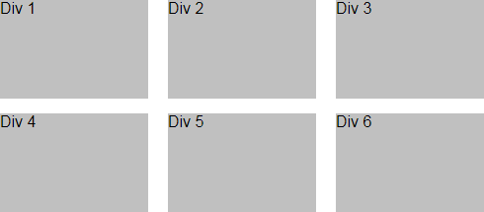
The layout for the 2x3 grid

Slide 6
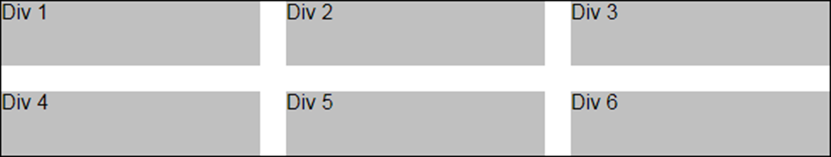
CSS that uses the repeat() function
main {
display: grid;
grid-template: repeat(2, 50px) / repeat(3, 1fr);
grid-gap: 20px;
}
The resulting layout

Slide 7
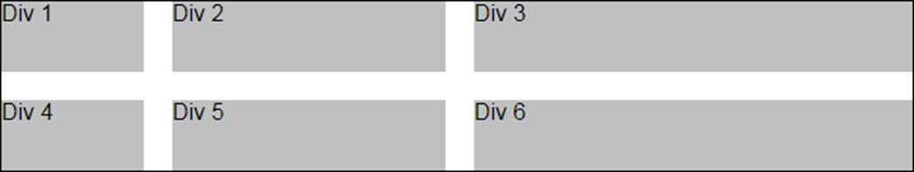
CSS that uses mixed units
main {
display: grid;
grid-template: repeat(2, 50px) / 100px 30% 1fr;
grid-gap: 20px;
}
The resulting layout

Slide 8
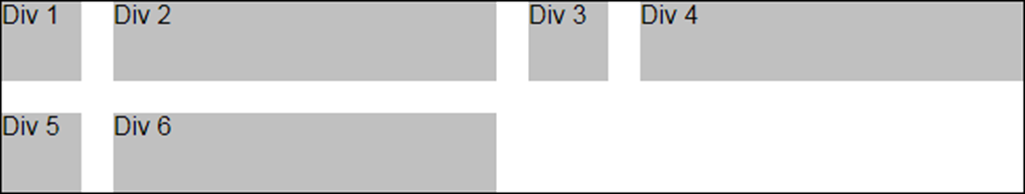
CSS that repeats two columns
main {
display: grid;
grid-template: repeat(2, 50px) / repeat(2, 50px 1fr);
grid-gap: 20px;
}
The resulting layout

Slide 9
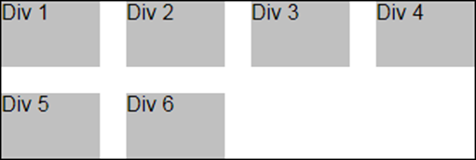
CSS that uses auto-fit and the minmax() function with the repeat() function
main {
display: grid;
grid-template:
repeat(2, 50px) / repeat(auto-fit, minmax(75px, 1fr));
grid-gap: 20px;
}
The layout when the container is 360 pixels wide
The layout when the container is 720 pixels wide

Slide 10
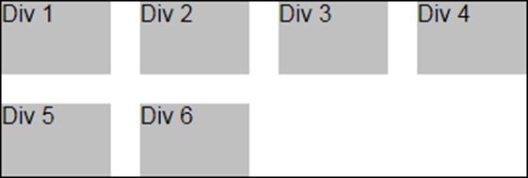
CSS that uses auto-fill and the minmax() function
main {
display: grid;
grid-template:
repeat(2, 50px) / repeat(auto-fill, minmax(75px, 1fr));
grid-gap: 20px;
}
The layout when the container is 360 pixels wide
The layout when the container is 720 pixels wide

Slide 11
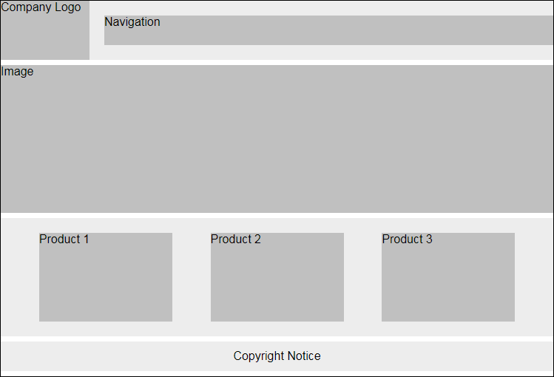
A page layout that uses alignment

Slide 12
A page layout that uses alignment
<body>
<nav class="navbar">
<div class="navbar-brand">Company Logo</div>
<div class="navbar-nav">Navigation</div>
</nav>
<section class="jumbotron">
<div>Image</div>
</section>
<main class="main">
<div>Product 1</div>
<div>Product 2</div>
<div>Product 3</div>
</main>
<footer class="footer">
Copyright Notice
</footer>
</body>

Slide 13
A page layout that uses alignment
.navbar {
display: grid;
width: 100%;
grid-template: 80px / 120px 1fr;
grid-gap: 20px;
}
.navbar-brand {
align-self: stretch;
}
.navbar-nav {
height: 40px;
align-self: center;
}
...

Slide 14
A page layout that uses alignment
.jumbotron {
display: block;
width: 100%;
min-height: 200px;
}
.main {
display: grid;
width: 100%;
min-height: 160px;
grid-template: 120px / repeat(3, 180px);
align-content: center;
justify-content: space-evenly;
}
.footer {
display: grid;
width: 100%;
min-height: 40px;
align-items: center;
justify-items: center;
}

Slide 15
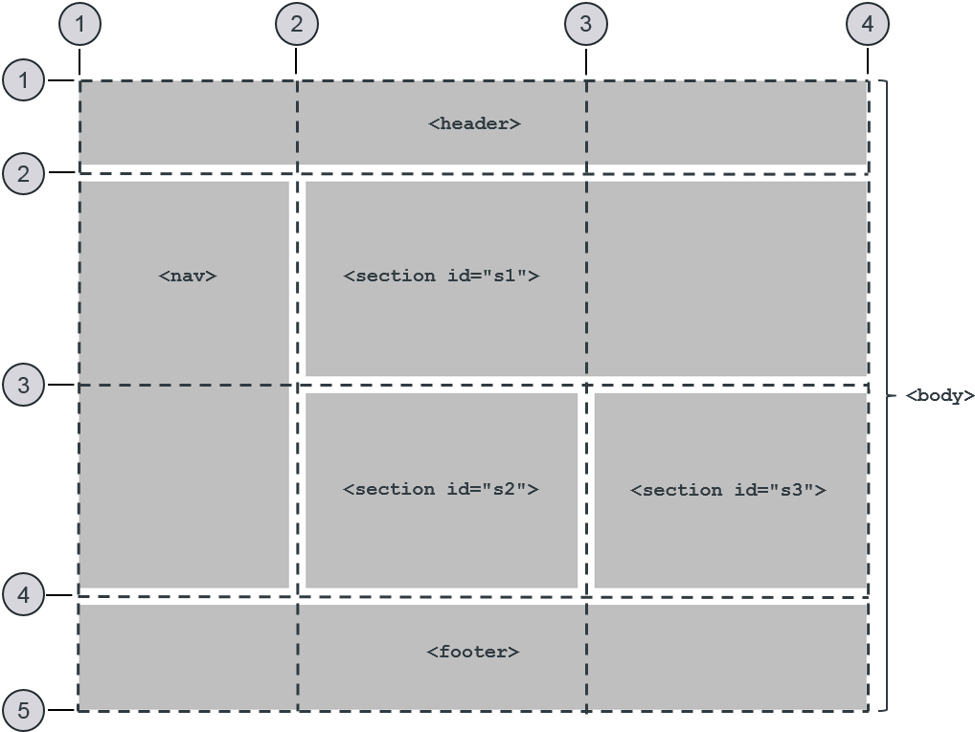
Using numbered grid lines to define the grid areas

Slide 16
Using numbered grid lines to define the grid areas
body {
margin: 0;
min-height: 600px; width: 100%; display: grid; grid-template-columns: 200px 1fr 1fr;
grid-template-rows: 80px 1fr 1fr 60px;
grid-gap: 16px;
}
header { grid-row: 1 / 2; grid-column: 1 / 4; }
nav { grid-row: 2 / 4; grid-column: 1 / 2; }
#s1 { grid-row: 2 / 3; grid-column: 2 / 4; }
#s2 { grid-row: 3 / 4; grid-column: 2 / 3; }
#s3 { grid-row: 3 / 4; grid-column: 3 / 4; }
footer { grid-row: 4 / 5; grid-column: 1 / 4; }

Slide 17
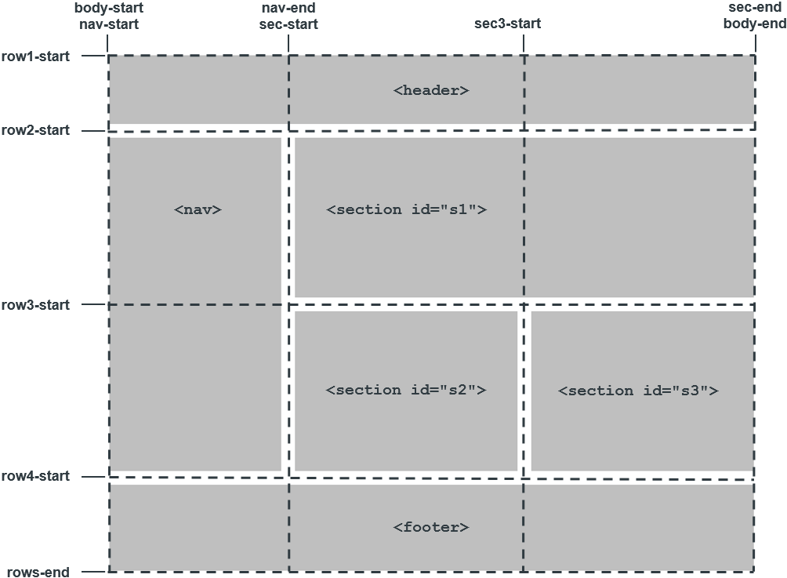
The named lines for a grid container

Slide 18
Using named lines to define the grid areas
body { display: grid;
grid-template-columns:
[body-start nav-start] 200px
[nav-end sec-start] 1fr
[sec3-start] 1fr
[sec-end main-end];
grid-template-rows:
[row1-start] 80px
[row2-start] 1fr [row3-start] 1fr
[row4-start] 60px
[rows-end];
grid-gap: 16px;
}
...

Slide 19
Using named lines to define the grid areas
header { grid-row: row1-start/row2-start;
grid-column: body-start/body-end; }
nav { grid-row: row2-start/row4-start;
grid-column: nav-start/nav-end; }
#s1 { grid-row: row2-start/row3-start;
grid-column: sec-start/sec-end; }
#s2 { grid-row: row3-start/row4-start;
grid-column: sec-start/sec3-start; }
#s3 { grid-row: row3-start/row4-start;
grid-column: column3-start/content-end; }
footer { grid-row: row4-start/rows-end;
grid-column: body-start/body-end; }

Slide 20
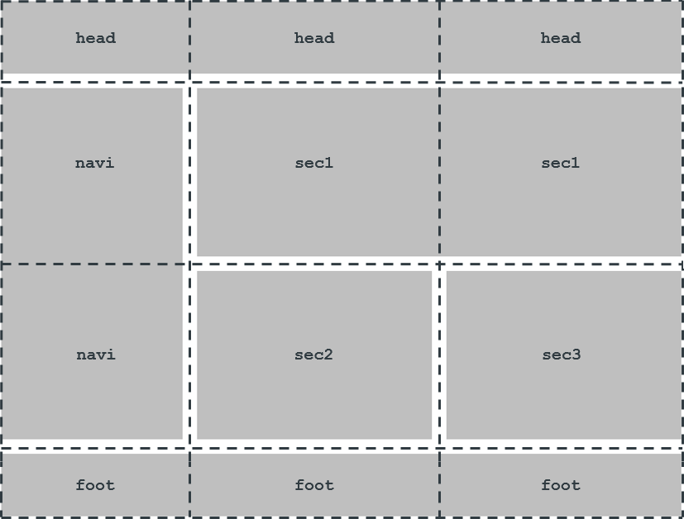
Using template names to define the grid areas

Slide 21
Using template names to define the grid areas
body {
display: grid;
grid-template-columns: 200px 1fr 1fr;
grid-template-rows: 80px 1fr 1fr 60px;
grid-gap: 16px;
grid-template-areas:
"head head head"
"navi sec1 sec1"
"navi sec2 sec3"
"foot foot foot";
}
header { grid-area: head; }
nav { grid-area: navi; }
#s1 { grid-area: sec1; }
#s2 { grid-area: sec2; }
#s3 { grid-area: sec3; }
footer { grid-area: foot; }

Slide 22
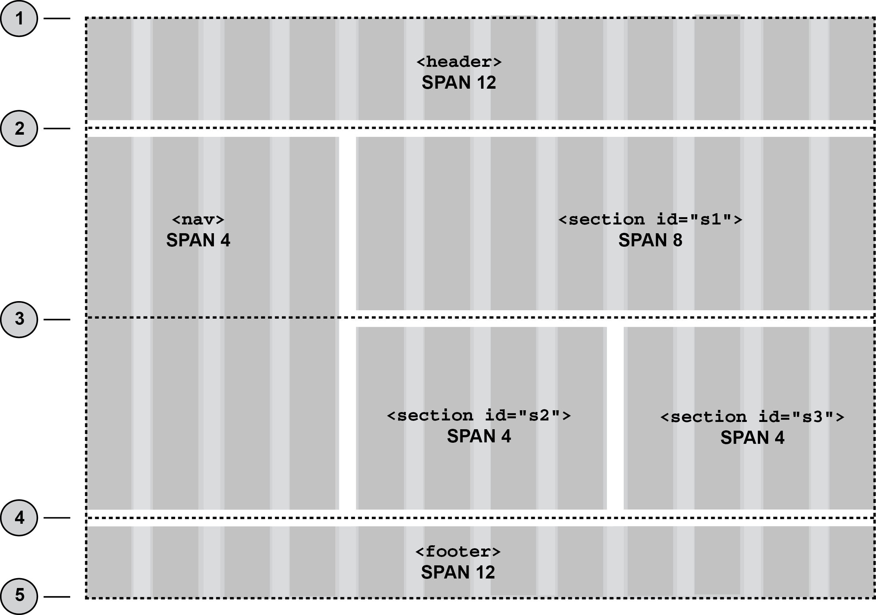
Using a 12-column grid to define the grid areas

Slide 23
Using a 12-column grid to define the grid areas
body {
display: grid;
grid-template-columns: repeat(12, 1fr);
grid-template-rows: 80px 1fr 1fr 60px;
grid-gap: 16px;
}
header { grid-row: 1 / 2; grid-column: 1 / span 12; }
nav { grid-row: 2 / 4; grid-column: 1 / span 4; }
#s1 { grid-row: 2 / 3; grid-column: 5 / span 8; }
#s2 { grid-row: 3 / 4; grid-column: 5 / span 4; }
#s3 { grid-row: 3 / 4; grid-column: 9 / span 4; }
footer { grid-row: 4 / 5; grid-column: 1 / span 12; }

Slide 24
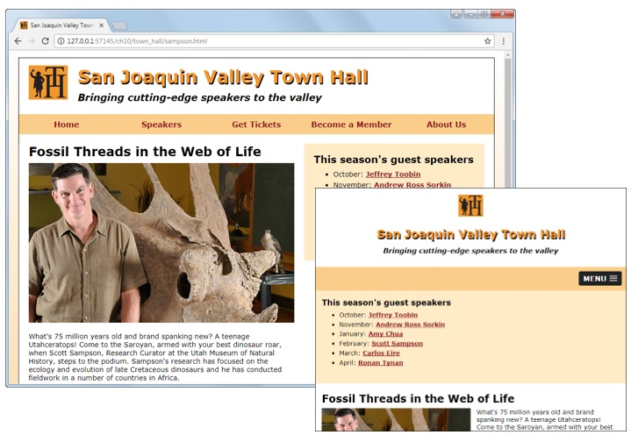
A speaker page in desktop and tablet layout

Slide 25
The code for the speaker page
with template areas
book_apps\ch10\ch10_template_areas\sampson.html
book_apps\ch10\ch10_template_areas\styles\speaker.css
with 12-column layout
book_apps\ch10\ch10_12_column\sampson.html
book_apps\ch10\ch10_12_column\styles\speaker.css

Slide 26
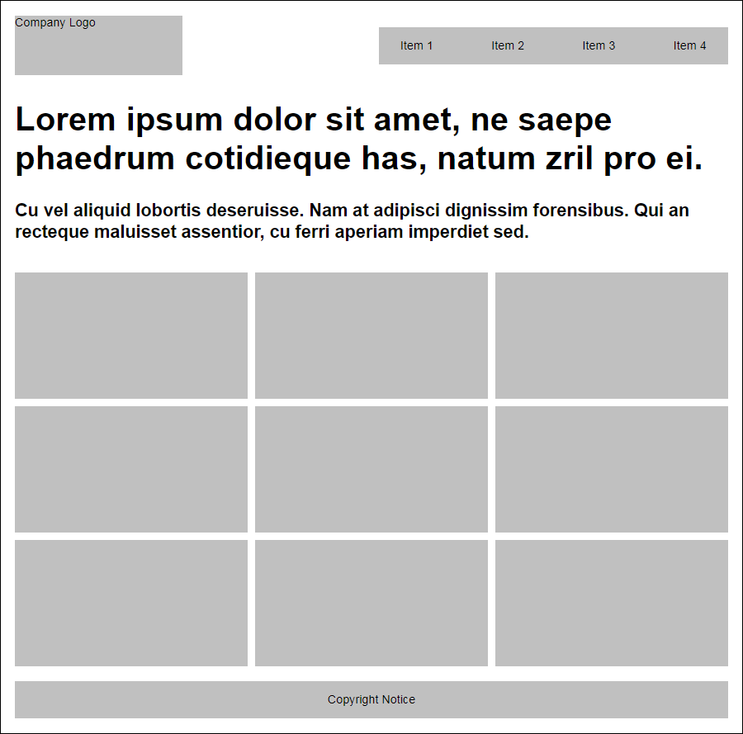
The headline and gallery layout

Slide 27
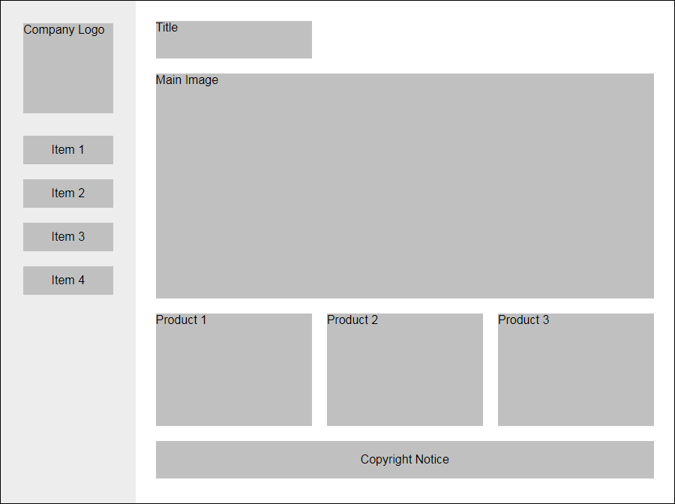
The fixed sidebar layout

Slide 28
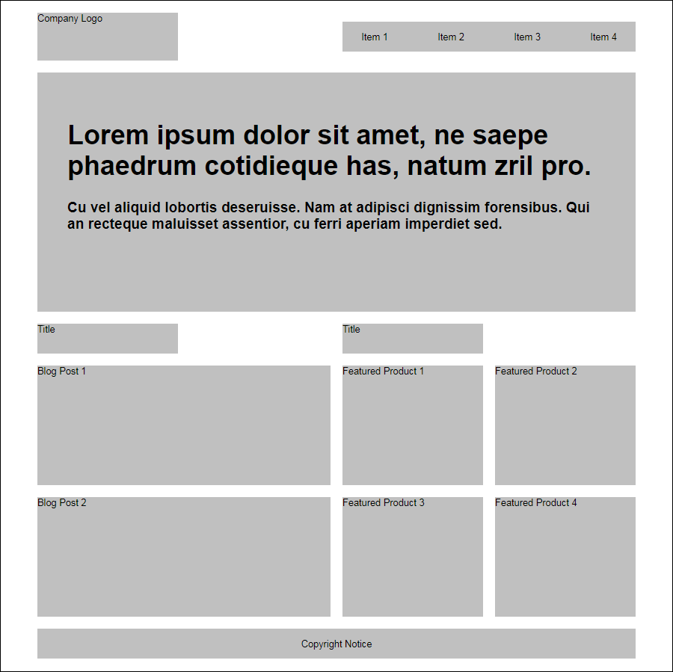
The advanced grid layout

Slide 29
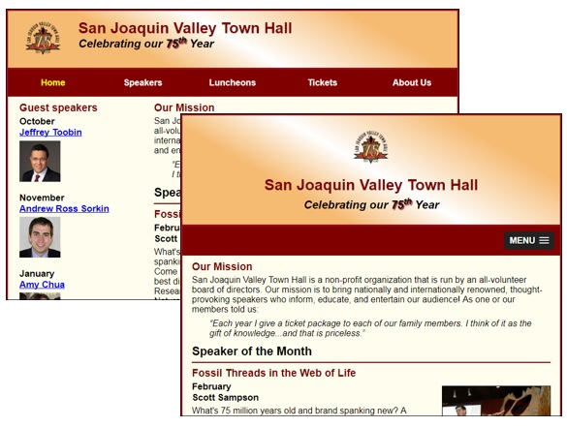
Short 10-1 Use a 12-column grid for the Town Hall home page

Slide 30
Objectives
Applied
Design responsive web page layouts with CSS Grid Layout.
Knowledge
Explain the benefits and usage of CSS Grid Layout.
Define these terms as they apply to Grid Layout: grid, grid track, grid line, grid cell, grid area, and grid item.
Explain how to define named template areas.

